Slide 1
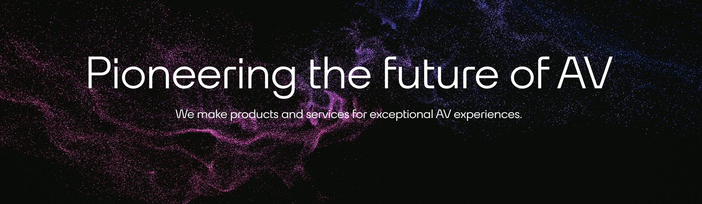


AUDINATE
Dante AV Project
Group6-CST01
Student ID | Name | Surname
202219044 | Yueheng | Wang
202219015 | Jun | Qi
202219077 | Jiayi | Li
202219102 | Xiaoyuanying | Kuang
202219072 | Fanghua | Dai

Slide 2





1
Introduction
2
Assumptions
3
Cash-FlowStatement & Viability Indicators
4
Risk Analysis
5
Recommendation
202219044-Yueheng Wang 王月姮

Slide 3

- CHAPTER 1 -
Intro& project description
202219044-Yueheng Wang 王月姮

Slide 4


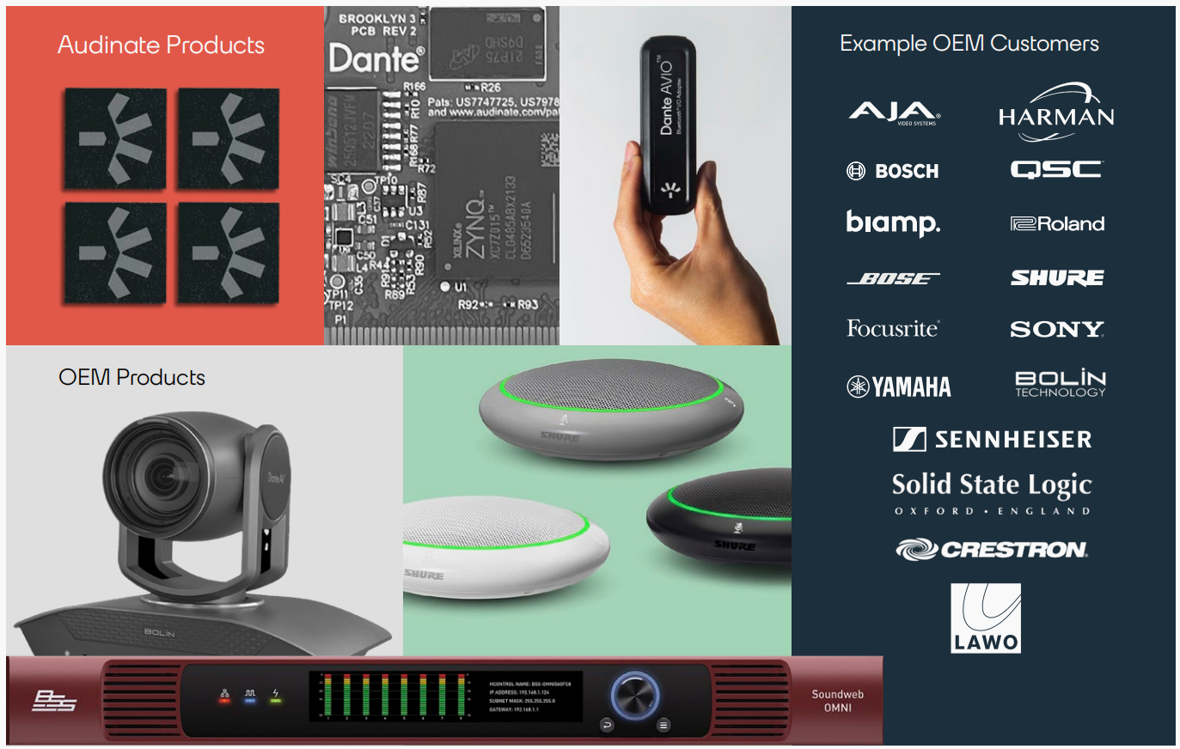
Dante AV -Audinate Group Limited
15 years
2019
Aims to revolutionize AV transmission Integrating advanced hardware
Software technologies
Using Ethernet-based transmission
Eliminates the complexity of traditional analog cabling
Enabling high-quality, low-latency synchronization
202219044-Yueheng Wang 王月姮

Slide 5
Company's financial status
Indicators | Values
Total assets | $189,474,000
Debt Ratio | 10.02%
Current Ratio | 8.88
Total Assets Turnover | 0.48
Return on Equity | 6.00%
Price-to-Earnings Ratio | 0.72
202219044-Yueheng Wang 王月姮

Slide 6
- CHAPTER 2 -
Assumptions
202219015-Jun Qi-齐军

Slide 7
Alternatives of the project
Enhanced Technology Adoption
Business as Usual
Alternative A
Alternative B
Focus on rapid tech advancements.
Focus on gradual improvements to existing features.
Target high-demand markets (education, offices).
Grow steadily by retaining existing customers
Boost adoption through innovation, and marketing
No major new investments
202219015-Jun Qi-齐军

Slide 8

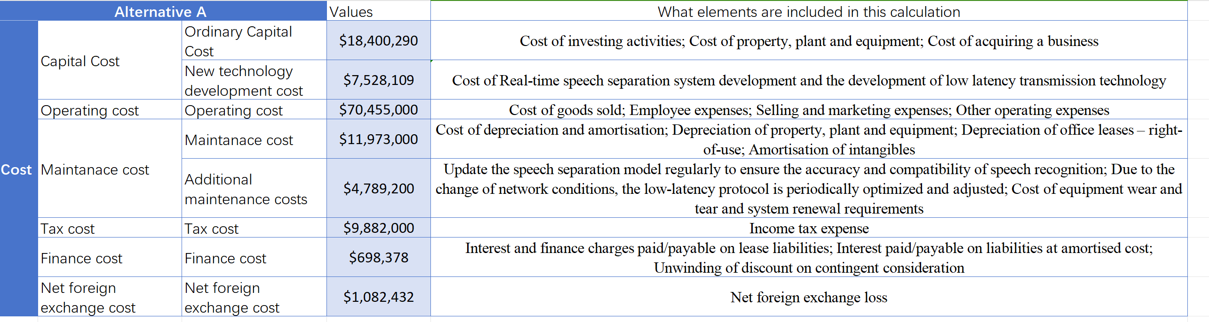
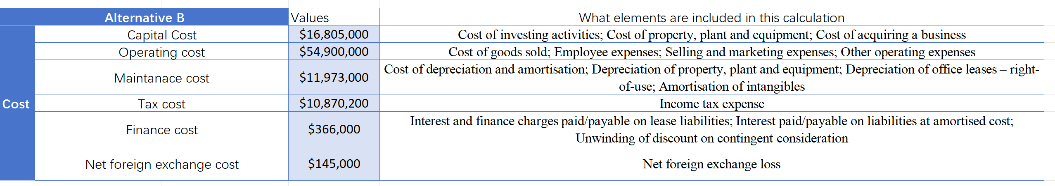
Costs
202219015-Jun Qi-齐军

Slide 9
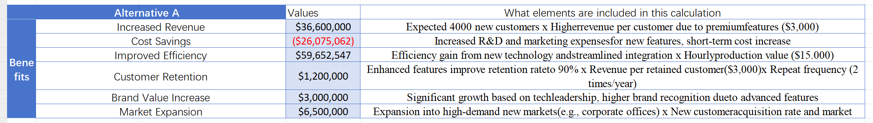
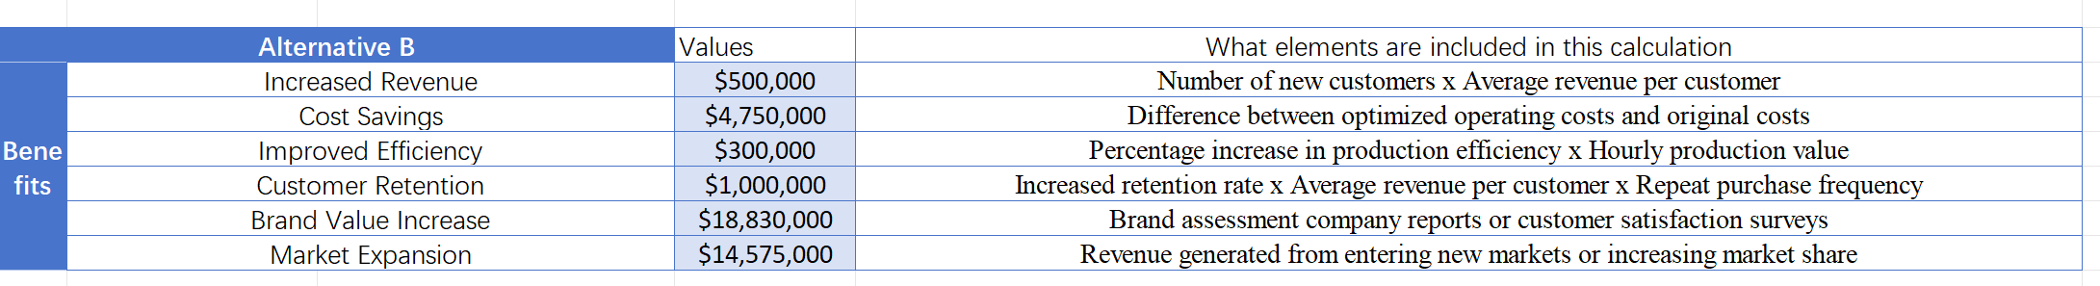
Benefits
202219015-Jun Qi-齐军

Slide 10
- CHAPTER 3 -
Cash-FlowStatement & Viability Indicators
202219077-Jiayi Li 李佳怡

Slide 11
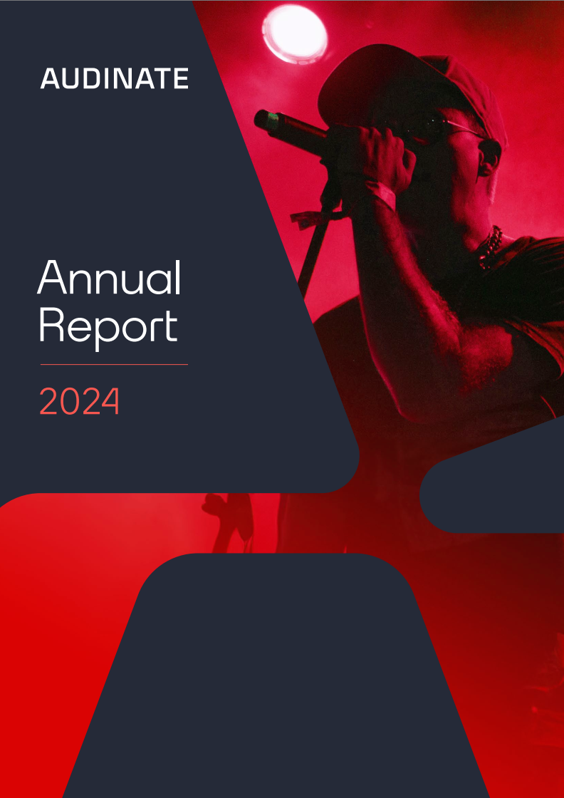
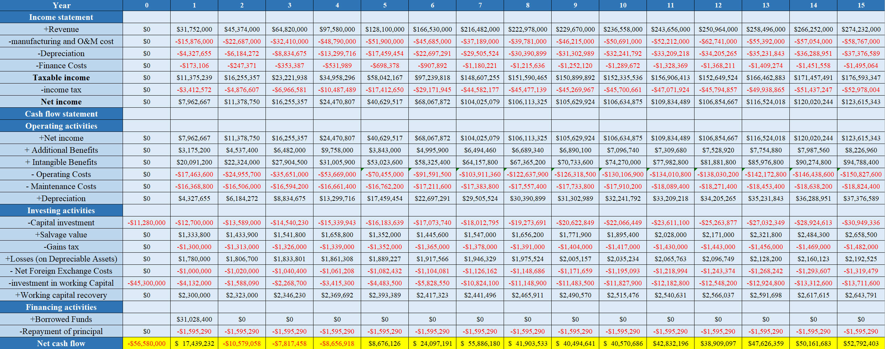
15years: 2019-2024
Alternative A- Cash Flow
30 %
Inflation rate: 2.96%
60% of the technology development cost
202219077-Jiayi Li 李佳怡

Slide 12

30 % increase
3 % increase
basic
Alternative B- Cash Flow
60 % of revenue
Inflation rate: 2.96%
202219077-Jiayi Li 李佳怡
7 % increase

Slide 13
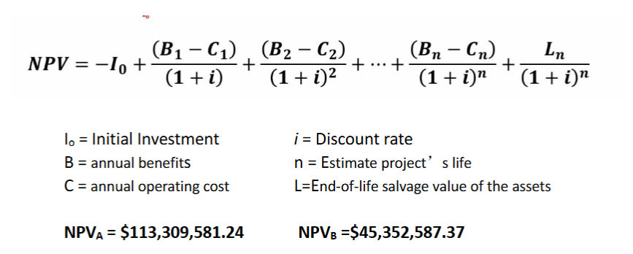
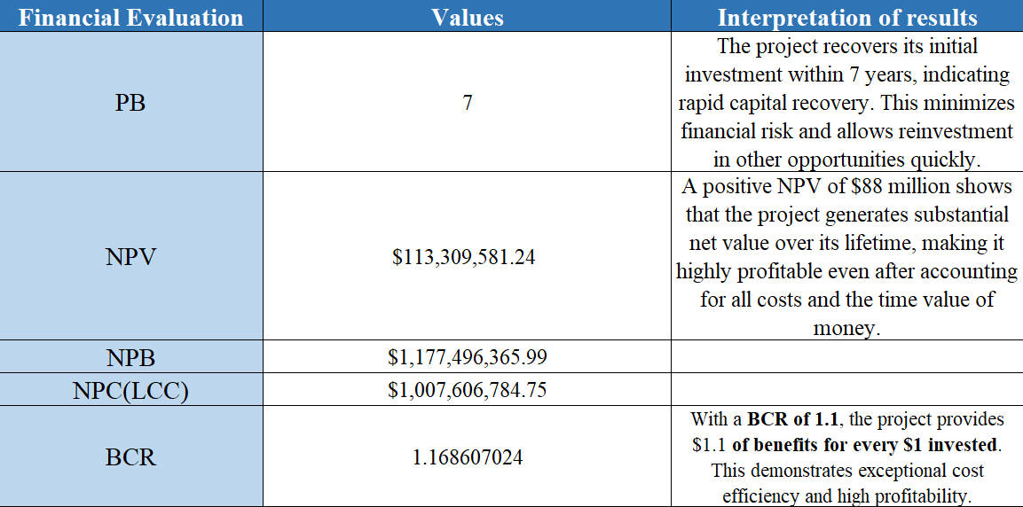
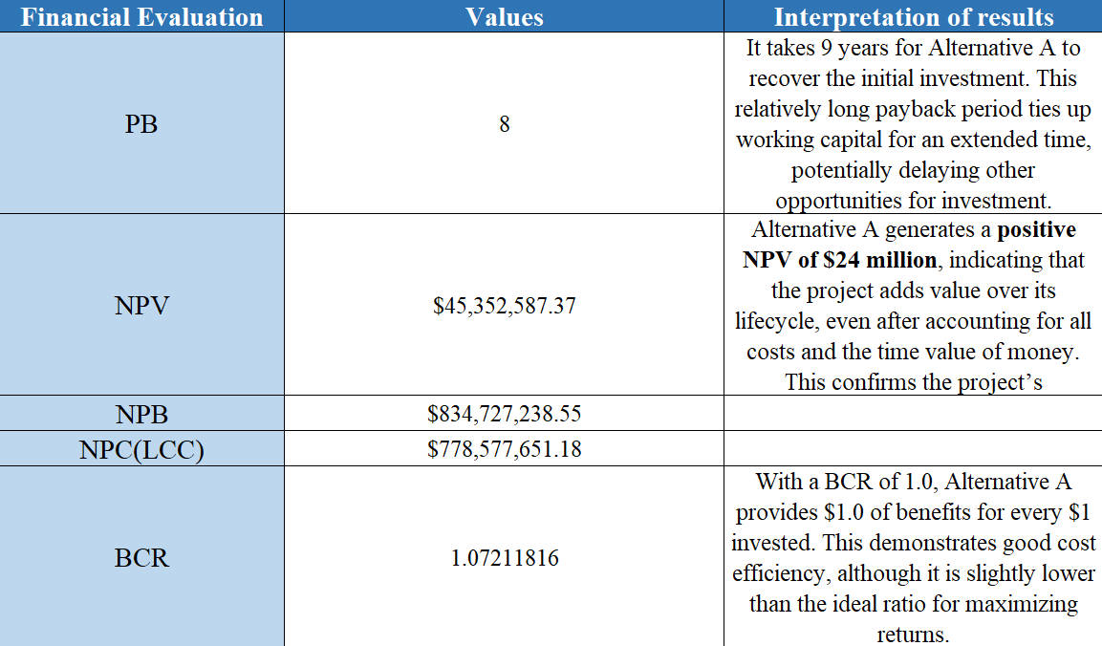
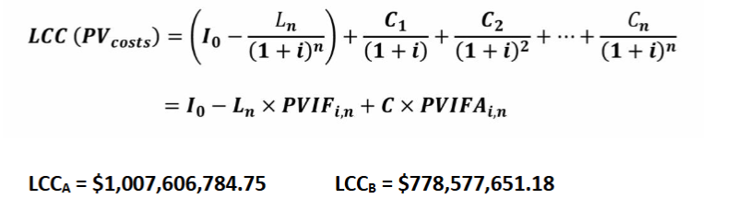
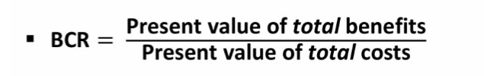
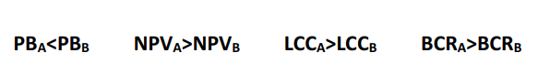
Alternative A-Viability Indicators
NPV values for both Alternative A and B are greater than 0
Alternative B -Viability Indicators
202219077-Jiayi Li 李佳怡

Slide 14
- CHAPTER 4 -
Risk Analysis
202219102-Xiaoyuanying Kuang 况小媛颖

Slide 15

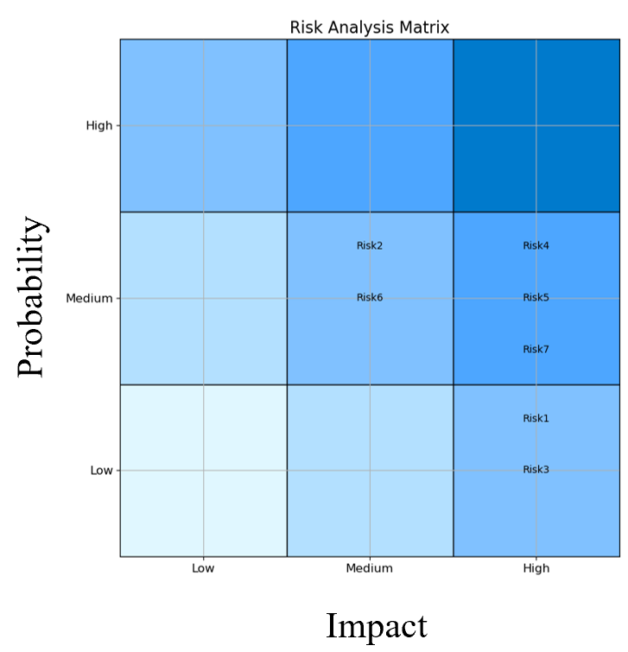
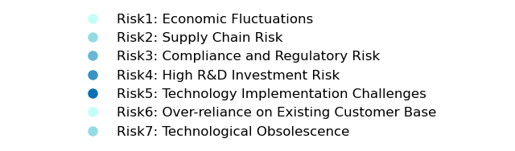
Qualitative Risk Analysis
Risk Category | Risk Name | Risk Type | Probability | Impact | Risk Description | Related Quantitative Variables
Common Risks | Economic Fluctuation Risk | Negative | Low | High | Economic fluctuations may cause changes in market demand, impacting revenue. | Discount Rate
 | Supply Chain Risk | Negative | Medium | Medium | Delays in raw materials, production, or logistics may increase costs and delays. | Operating Costs, Net Income
 | Compliance and Regulatory Risk | Negative | Low | High | Stricter regulations could cause fines, business interruptions, or reputational loss. | Operating Costs, Net Income
Alternative A Risks | High R&D Investment Risk | Negative | Medium | High | Large R&D investments may result in budget overruns and cash flow issues. | Capital Investment, Net Income
 | Technology Implementation Challenges | Negative | Medium | High | New technology may face compatibility or performance issues, increasing costs. | Operating Costs, Net Income
Alternative B Risks | Over-reliance on Existing Customers | Negative | Medium | Medium | Dependence on existing customers may result in revenue loss if customers leave. | Net Income, Additional Benefits
 | Technological Obsolescence | Negative | Medium | High | Lack of innovation may render existing technology obsolete, reducing market share. | Net Income, Capital Investment
202219102-Xiaoyuanying Kuang 况小媛颖

Slide 16
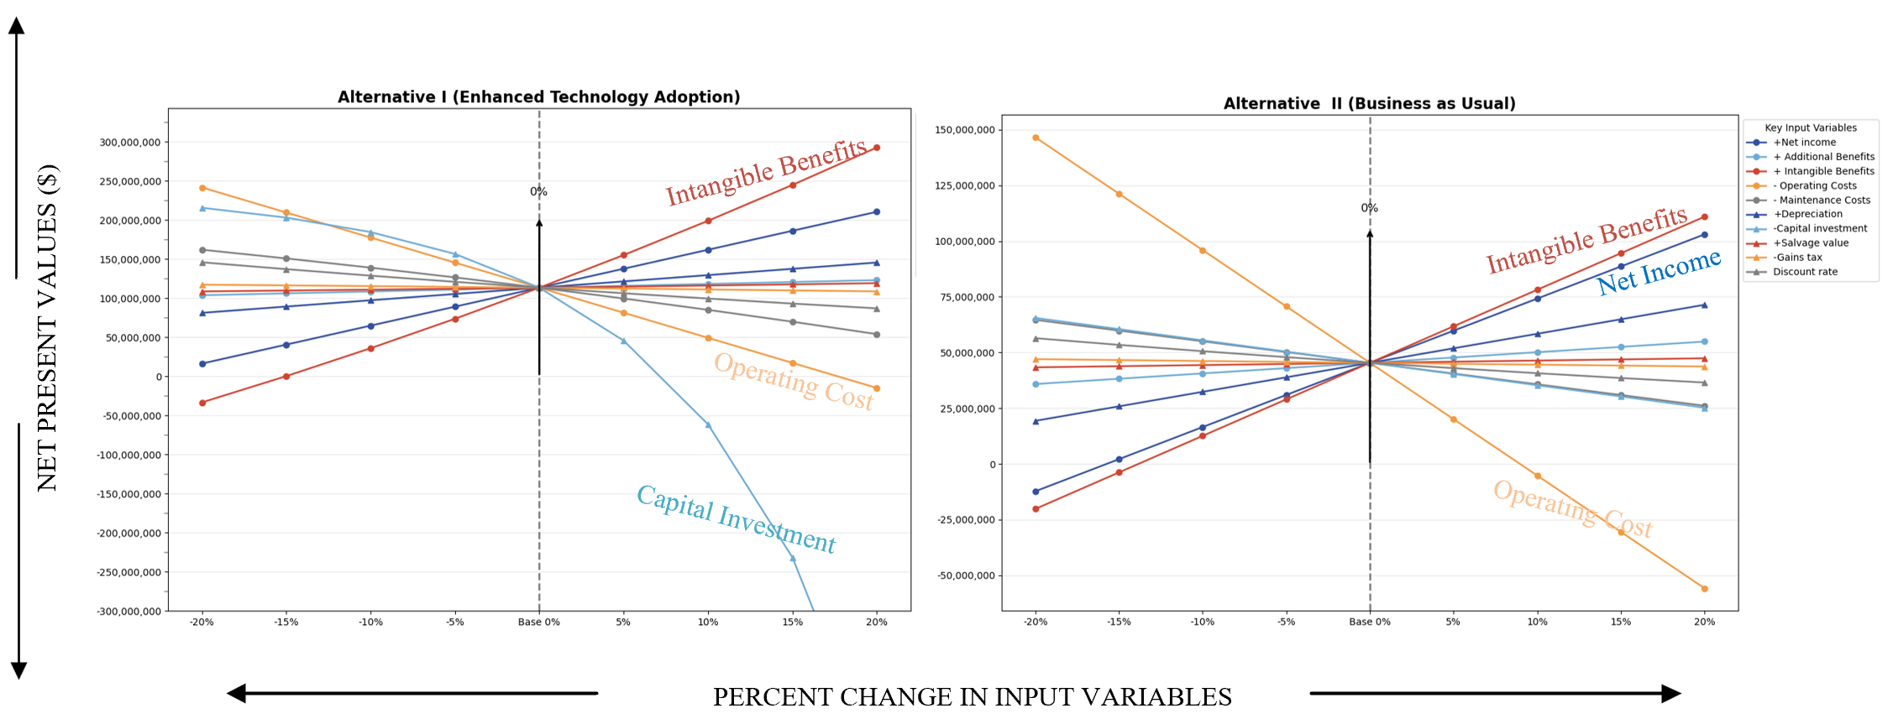
Sensitivity Analysis
Quantitative Risk Analysis
A
B
Capital investment has the greatest impact on NPV, followed by operating costs and intangible benefits.
suitable for projects seeking long-term returns but is sensitive to fluctuations in capital investment and operating costs.
Operating costs have the greatest impact on NPV, followed by intangible benefits and net income.
focuses more on risk control and demonstrates strong NPV stability, making it suitable for projects prioritizing financial stability.
202219102-况小媛颖

Slide 17
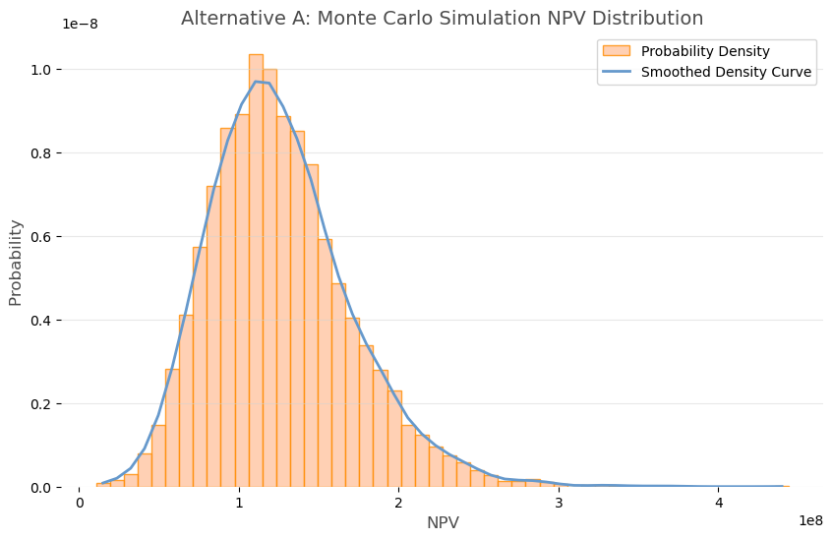
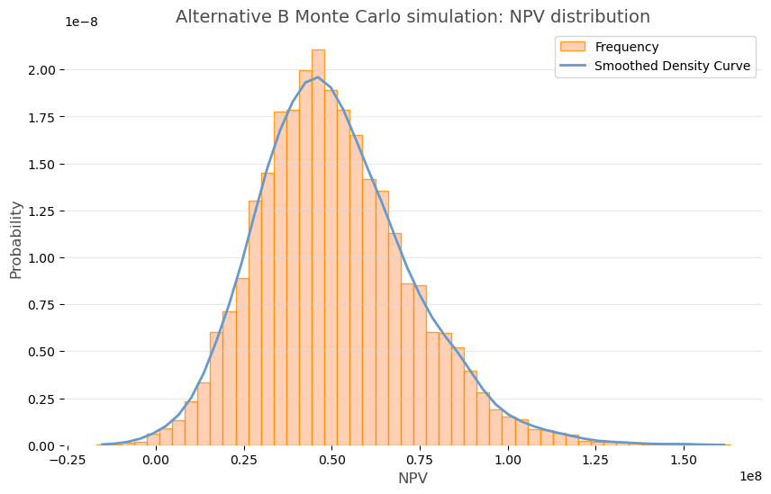
Monte_Carlo Methods
AlternativeA
Expected Net Present Value | 124937838.89
Max | 429614004.52
Min | -2238747.15
Standard Deviation | 44445864.41
Alternative A has a wider range of outcomes, with a higher expected NPV, but also a higher standard deviation, indicating more volatility.
AlternativeB
Expected Net Present Value | 50754600.31
Max | 163307042.96
Min | -16973452.51
Standard Deviation | 21683083.05
Alternative B provides a more stable NPV with lower risk, making it a safer choice for financial stability.
202219102-Xiaoyuanying Kuang 况小媛颖

Slide 18
- CHAPTER 5 -
Recommendation
202219072-Fanghua Dai 戴方华

Slide 19



Recommendation
It is recommended that decision makers actively support Alternative A.
Although there are certain R&D and market risks associated with the project, the company can mitigate these risks through effective risk management and market strategies.
Suggestions for improving the company's financial position:
1. Accurate budgeting and money management
2. Diversified financing channels
3. Strengthen marketing and branding
4. Establish risk warning and response mechanisms
Weaknesses in analyses
Do not identify factors such as possible policy influences or market movements.
It may lead to unforeseen obstacles in the implementation of the project, which will affect the overall benefit of the project and the realization of the company's strategic objectives.
202219072-Fanghua Dai 戴方华

Slide 20

Bibliography
[1]Audinate Annual Report 2024.https://www.audinate.com/company/history.2024
[2]Smith, J. (2020). "The Growth of Ethernet-Based AV Solutions: A Case Study of Dante AV." Journal of Audio-Visual Technologies, 15(3), 45-58.
[3]Ruegg, R. T., & Marshall, H. E. (1990). Payback (PB). In Springer eBooks (pp. 92–104). https://doi.org/10.1007/978-1-4757-4688-4_7
[4]Gallo, A. (2014). A refresher on net present value. Harvard Business Review, 19, 1-6.
[5]Larsen, V. G., Tollin, N., Sattrup, P. A., Birkved, M., & Holmboe, T. (2022). What are the challenges in assessing circular economy for the built environment? A literature review on integrating LCA, LCC and S-LCA in life cycle sustainability assessment, LCSA. Journal of Building Engineering, 50, 104203. https://doi.org/10.1016/j.jobe.2022.104203
[6]Australian Bureau of Statistics物价指数和通货膨胀 |澳大利亚统计局 --- Price indexes and inflation | Australian Bureau of Statistics
202219072-Fanghua Dai 戴方华

Slide 21
Thanks
for
Listening

